Slide 1

Hands on Introduction to
Data Science and IBM’s Data Science Experience
Power of data. Simplicity of design. Speed of innovation.
Bernie Beekman
Notes:
Welcome to ….
Be sure to document on the whitebioard the urls
for DSWB
for lab Notebooks ibm.box.xom/IntroApacheSpark Passsword = IBMSpark
for the POT Survey
Note the survey will revela the instructor notebooks upon completion.

Slide 2

Hands on Introduction to Data Science and DSX Agenda
1:30 – 2:30 - Kick off
Overview of Watson Data Platform, Data Science Experience, and Spark Register for Platform – datascience.ibm.com
2:30 - 3:30 - Lab 1 – Learning Data Science Experience
Overview – 10 Minutes
Hands on Exercises
3:30 – 4:45 Lab 2 – Machine Learning for Classification (Bernie)
Overview of Lab Lunch/Hands on Exercises
4:45 – 5:30 – Lab 3 – R, Shiny and GUI interfaces
Overview of Lab Hands on Exercises

Slide 3


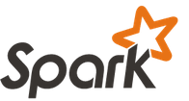
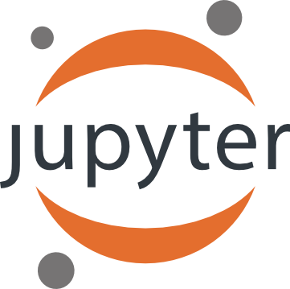
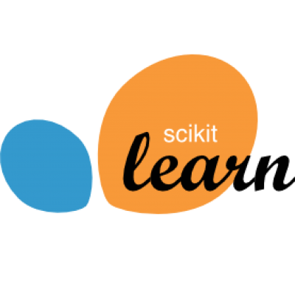

Data Science Technologies …
{
} R
{
} Big Data
{
} Python

Slide 4
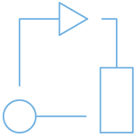


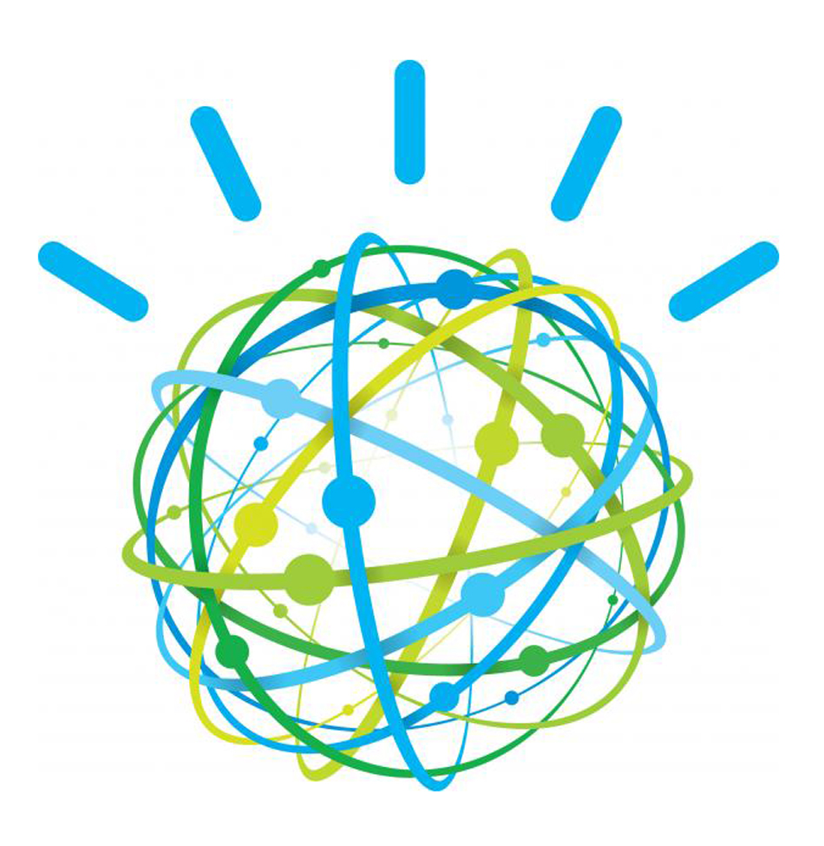
IBM Watson Data Platform
Mission: Make Data Simple and Accessible to All
Platform.
Method.
Ecosystem.
http://ibm.co/makedatasimple

Slide 5





IBM Watson Data Platform Experience New Ways To Put Data To Work
Data Engineering
Data Science
Business Analysis
App Development
Experiences
task-specific, collaborative
Data and Analytics Services
comprehensive
open • intelligent • hybrid

Slide 6



IBM Watson Data Platform
Connects Users to Data and Analytics
Data Engineering
Data Science
Business Analysis
App Development
common data, pipelines and projects
Find
Share
Collaborate
Iterate
analytics operating system
Discovery / Exploration
Machine learning
Model development
Data Sources
On-premises / cloud
Structured / unstructured
In-motion / at-rest
Internal / external
Analyze
Ingest
Deploy
Integration
Matching / Quality
Streaming
Persist
Reports / Dashboards
Applications
APIs
Hadoop
NoSQL / SQL
Object store
Govern
Data Assessment Metadata / Policies

Slide 7

Primary persona – Data Scientist
Rigid toolset
Have to choose one and only one approach
Cannot easily connect all of the capabilities needed
Difficult to navigate between the various tools used
Fragmented and time consuming
Using multiple disjointed environments
Separate on-ramp/community for each tool/environment
Does not have meta data or data lineage
Analytical Silo
Difficult to maintain and version control project assets
Limited means of collaborating with team
Results are difficult to share

Slide 8




Data Science Experience
Brings together popular Data Science Open Source tools with IBM value-add functionalities coupled with community and social features
Learn
Create
Collaborate
Built-in learning to get started or go the distance with advanced tutorials
The best of open source and IBM value-add to create state-of-the-art data products
Community and social features that provide meaningful collaboration
External URL: http://datascience.ibm.com

Slide 9
Core Attributes of the Data Science Experience
IBM Data Science Experience
Community
Open Source
IBM Added Value
Find tutorials and datasets
Read articles and papers
Connect with Data Scientists
Share comments
Copy and share notebooks
Code in Scala/Python/R/SQL
Jupyter Notebooks
RStudio IDE and Shiny
Apache Spark
Your favorite libraries
IBM Machine Learning*
SPSS Modeler Canvas*
Prescriptive Analytics - DOcplexcloud
Projects and Version Control
Managed Spark Service
Powered by IBM Watson Data Platform
* Closed beta

Slide 10
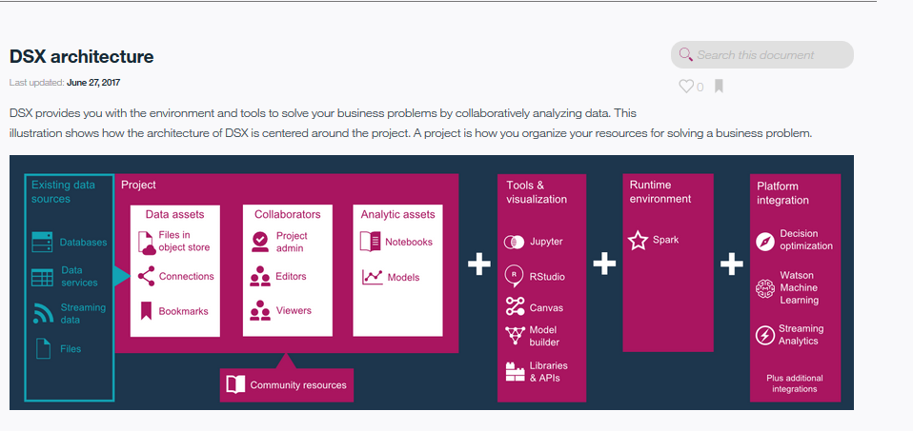
DSX Architecture

Slide 11
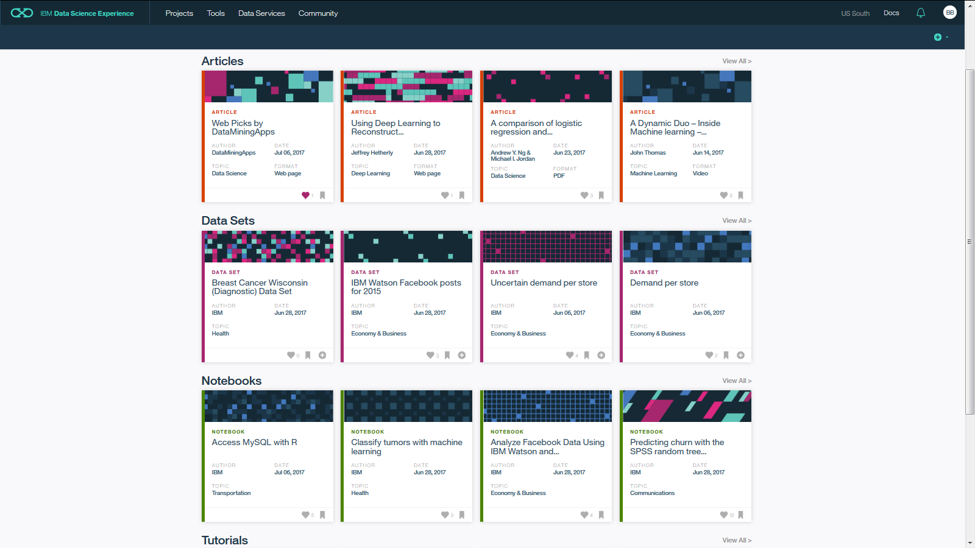
Community Cards provide in-context learning for users

Slide 12
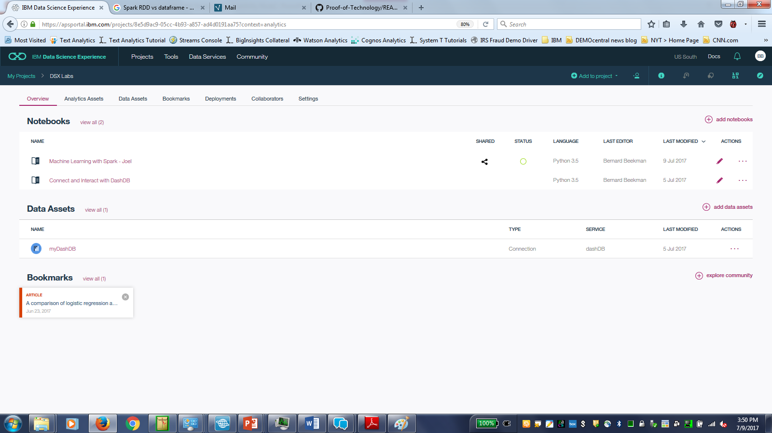
Collaborate Using Projects

Slide 13
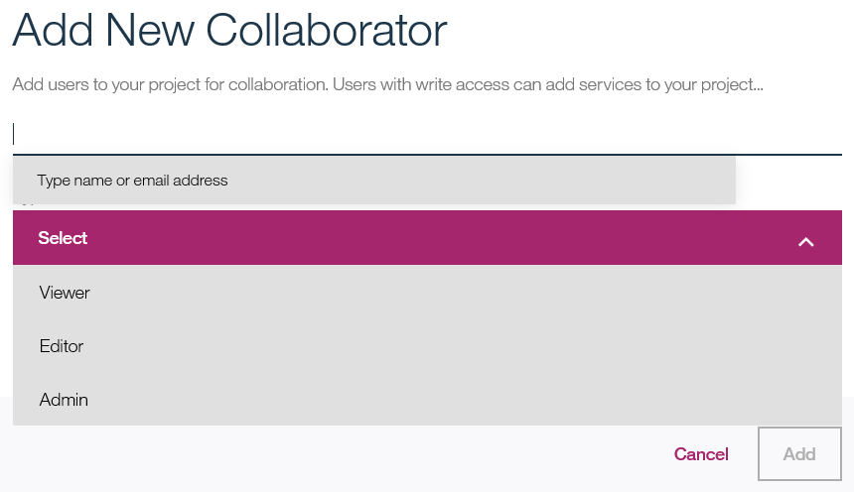
Add Collaborators to a Project

Slide 14
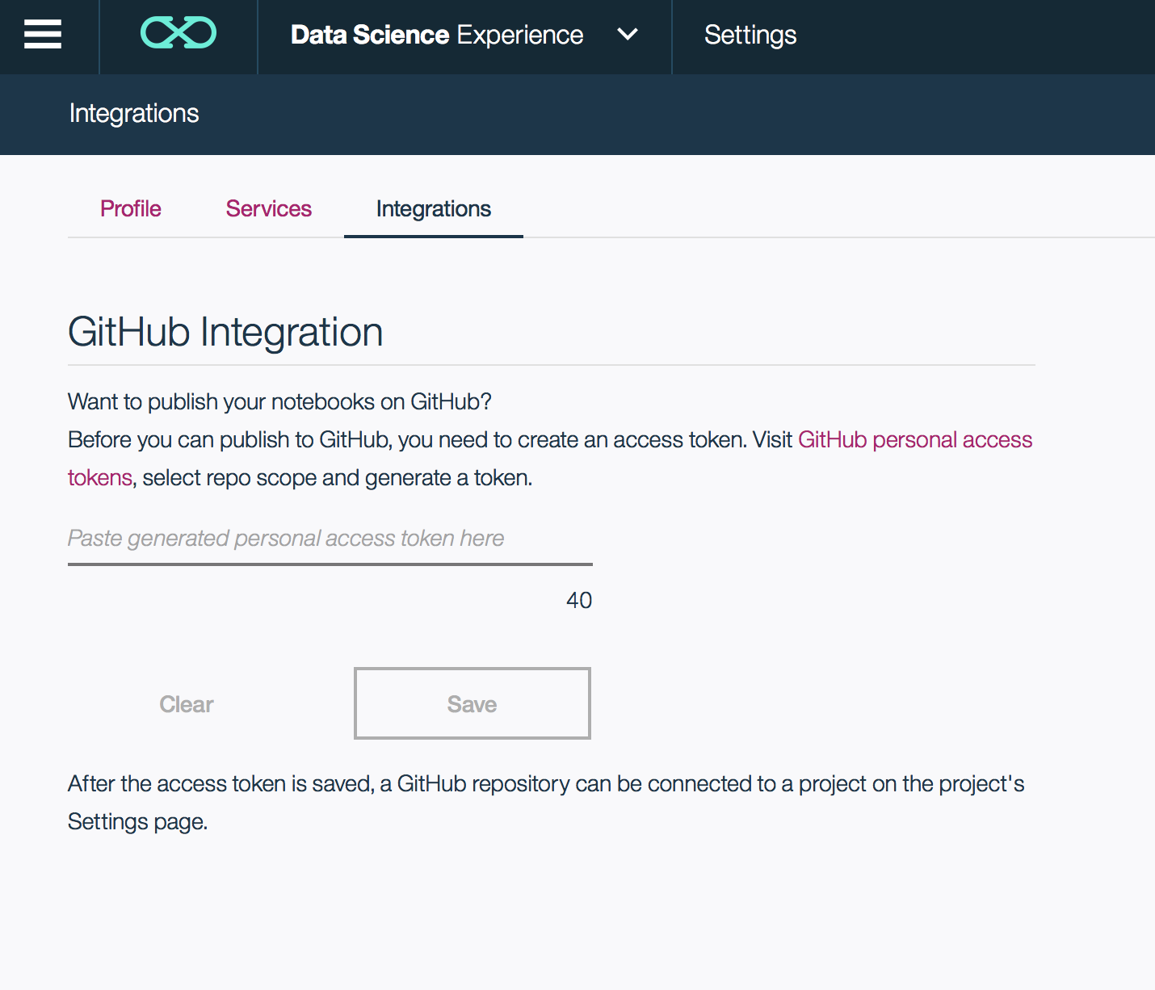
GitHub Integration

Slide 15
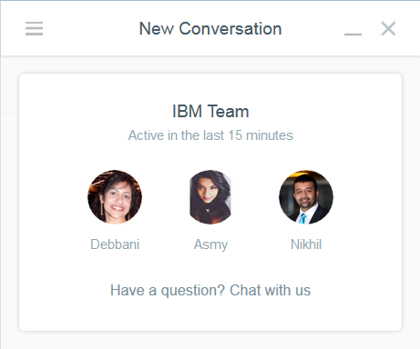

Live chat on Intercom for support from the IBM team and to provide your feedback on how we can improve DSX

Slide 16
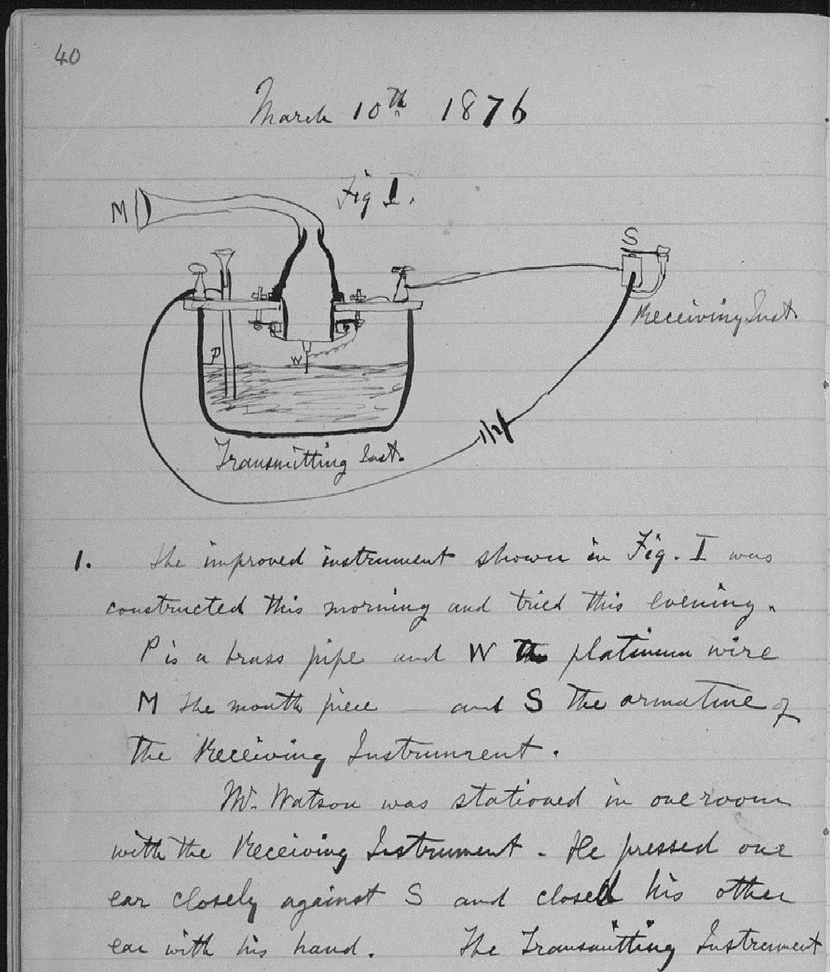
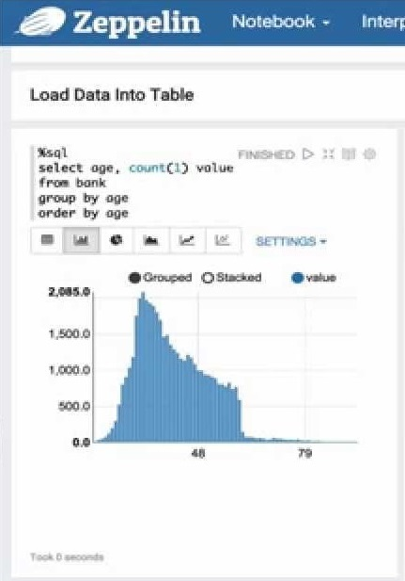
What is a “Notebook”?
Pen and Paper
Notebooks
Pen and paper has long provided the rich experience that scientists need to document progress through notes and drawings:
Expressive
Cumulative
Collaborative
Notebooks are the digital equivalent of the “pen and paper” lab notebook, enabling data scientists to document reproducible analysis:
Markdown and visualization
Iterative exploration
Easy to share

Slide 17
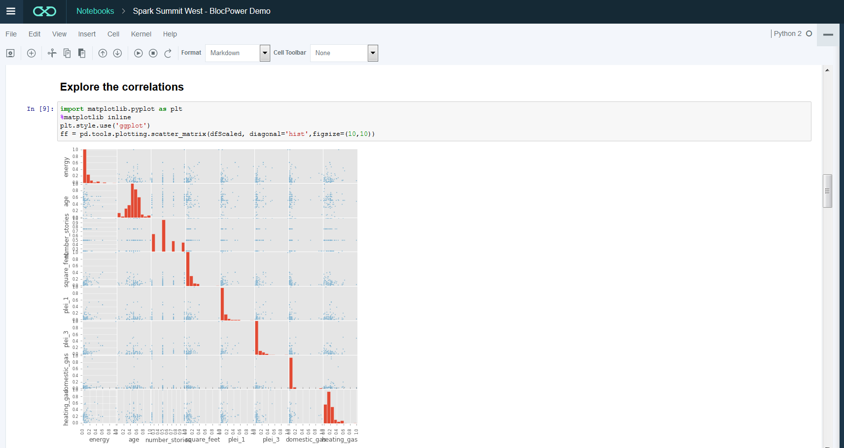
Integrated Jupyter Notebooks for interactive and collaborative development - seamless execution on Spark

Slide 18






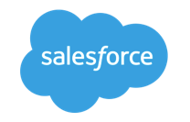



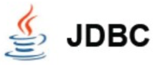


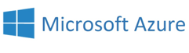
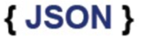



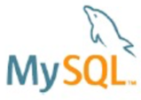

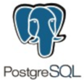






From a Notebook in DSX you can use IBM’s managed Spark Service to blend multiple data types, sources, and workloads
Execute SQL Statements
Streaming Analytics via Micro-batch
M.L. and Statistical Algorithms
Distributed Graph Processing Framework
Spark SQL
Spark Streaming
MLlib Machine Learning
Graph
General compute engine
Basic I/O functions
Task dispatching
Scheduling
Spark Core
Data Sources
IBM Cloud | Public Cloud | Cloud Apps | On-Premises
BigInsights (HDFS)
Cloudant (DBaaS)
dashDB (Analytics)
SQDB (Managed DB2)
Swift (Object Storage)
Notes:
From a Notebook in DSX you can use IBM Analytics for Apache Spark to blend multiple data types, sources, and workloads. IBM Analytics for Apache Spark is a fully managed service on Bluemix.
For example, Spark SQL is available to address the needs of so many of our current customers and partners that want to be able to work with their traditional relational databases, using a performant and powerful technology like Spark, but be able to do so without needing to know how to code MapReduce jobs in Java.
Using SparkSQL, a developer can apply their knowledge of SQL statements directly in Spark code, and tap into a large number of relational databases Spark supports in order to apply in-memory analytics over bread and butter relational SQL databases.
And beyond SparkSQL, we can attack new problems with Spark’s machine learning library, Spark Streaming, and Graph. The power of Spark is the ease of developing analytics applications using a unified framework across all of these libraries. For more details on this please check the appendix of this deck.
Towards the bottom of the slide, I've highlighted the connection opportunities we have with Spark today – and keep in mind that this list is not exhaustive and is ever-expanding. Focus your attention particularly on the integrations with the IBM portfolio (on the left) that we support currently. Of course, the logical fits are there: connect Spark to BigInsights On-Premises or BigInsights on Cloud to land your data in HDFS and access the suite of enterprise-grade technologies we support atop BigInsights. But consider as well the dramatic innovations in areas like our button-push connectivity to databases like NoSQL database-as-a-service Cloudant. Application developers, Web services, and mobile apps now have direct-line access to an in-memory analytic processing framework that can even handle near-real time ingest of data from Internet of Things data streams and messaging hubs.
The best practice for the Spark service is using object storage (Swift) as the data store.

Slide 19

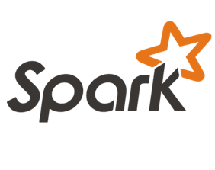
Benefits of Spark for Data Science
Spark SQL
Spark Streaming
MLlib Machine Learning
GraphX Graphing
General compute engine
Basic I/O functions
Task dispatching
Scheduling
+
Spark Core
Allows Data Scientists to code at scale
In-Memory processing that scales in a distributed architecture
Supports multiple programing interfaces (Scala, Python, Java and R)
Provides unified APIs (SQL, Streaming, Machine Learning, etc.)

Slide 20
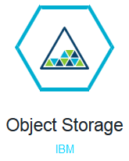
The Spark service uses Bluemix Object Storage as its preferred data store for building performant applications
Object storage provides inexpensive, scalable and self-healing retention of massive amounts of unstructured data
Every object exists at the same level in a flat address space
Bluemix Object Storage has a drag-and-drop upload and Swift API for programmatic access

Slide 21



Supported Data Sources/Targets for DSX via on- premises and cloud Connectors
Cloud Sources
Amazon Redshift
On-Premises Sources
Apache Hive
Cloud Targets
Amazon S3
On-Premises Targets
IBM DB2® LUW
Amazon S3
Cloudera Impala
Bluemix Object Storage
IBM Pure Data for Analytics®
Apache Hive
IBM DB2® LUW
IBM Cloudant™
Teradata
Bluemix Object Storage
IBM Informix®
IBM dashDB
IBM BigInsights™ on Cloud
*
IBM DB2® on Cloud
IBM BigInsights™ on Cloud *
IBM Pure Data for Analytics®
IBM Cloudant™
Microsoft SQL Server
IBM dashDB
MySQL Enterprise Edition
IBM SQL Database
IBM DB2® on Cloud
Oracle
IBM Watson™ Analytics
IBM SQL Database
Pivotal Greenplum
PostgreSQL on Compose
Microsoft Azure
PostgreSQL
SoftLayer Object Storage
PostgreSQL on Compose
Sybase
Salesforce
Sybase IQ
SoftLayer Object Storage
Teradata
21
All of the supported targets are compatible with each source
© 2015 IBM Corporation

Slide 22
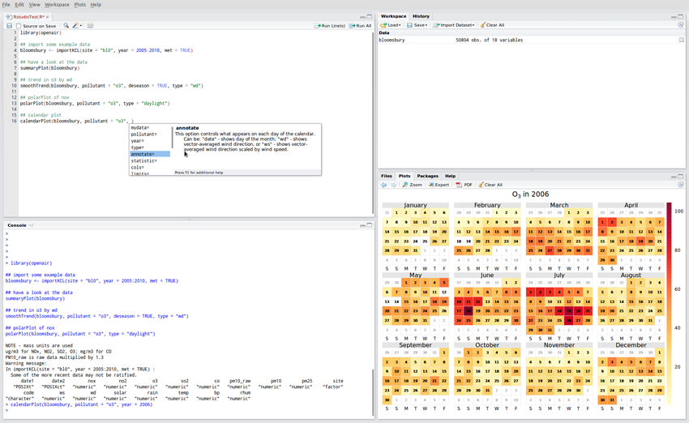
DSX has RStudio built into the experience thanks to our strategic partnership

Slide 23
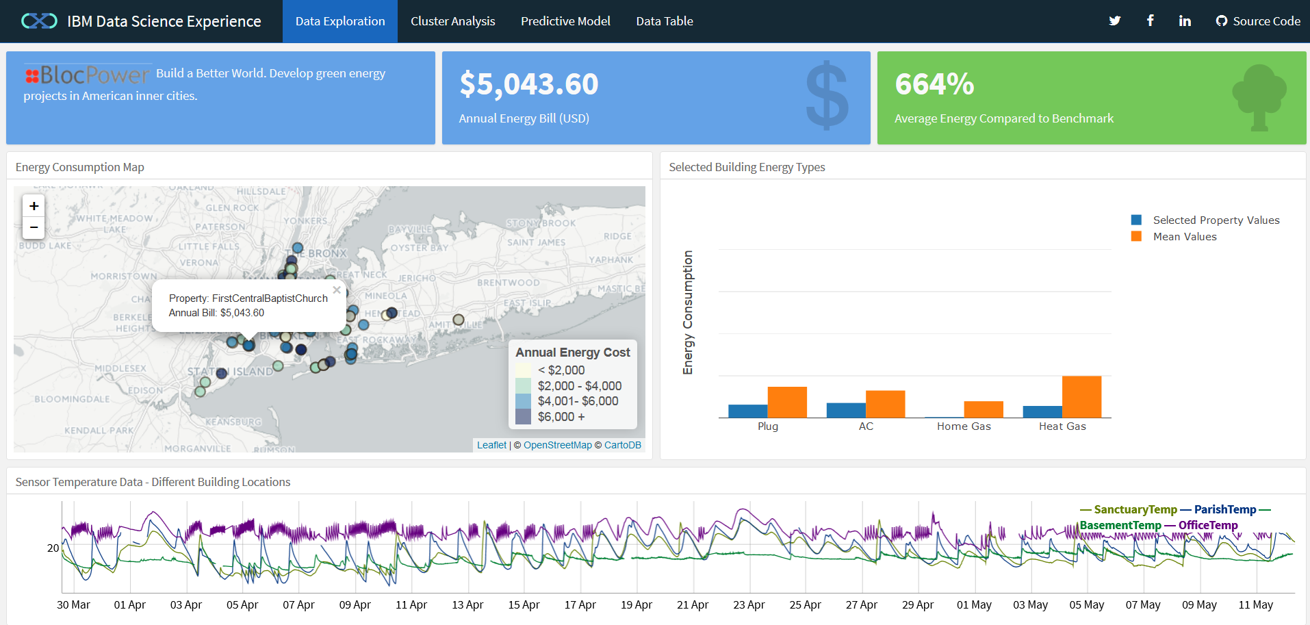
With RStudio you can create Shiny web applications to make your analysis accessible to the business

Slide 24
DSX Local
Very similar to the public cloud version of DSX
Runs on hardware that is provided by the customer
The DSX Local software and hardware are managed by the customer
DSX Local comes with all the software it needs to run, although it can integrate with existing customer systems such as
Databases and HDFS storage
LDAP servers for authentication

Slide 25
Get Started with Data Science Experience Today!
Calling all Data Scientists!
Our mission is to win the hearts and minds of Data Scientists
IBM Data Science Experience is a freemium model with value-add features, pricing and up-sell in development
Sign up and encourage your colleagues to do so at
datascience.ibm.com

Slide 26

IBM Data Science Experience https://www.youtube.com/watch?v=1HjzkLRdP5k&t=29s
Notes:
IBM Data Science Experience has been developed based on interviews with 100s of Data Scientists and the feedback of 1000s of users. Watch this design video at https://www.youtube.com/watch?v=HPzXlFp4rKE to learn more about how and why we created the Data Science Experience.

Slide 27

What is Spark?
Spark is an open source
in-memory
application framework for
distributed data processing and
iterative analysis
on massive data volumes
“Analytic Operating System”
Notes:
Spark isn't a data store as it has to connect to other relational, non relational data stores, as well as handling data at rest and data on the fly (streams of data Other than the doesn't’t have its own.
Spark isn't only for Spark is a separate stand-alone system or service
Spark isn't only for Hadoop as it can be used without Hadoop as well, and to process and analyze data sources in other data sources like DashDB, any relationship database, Cloudant, Cassandra and Amazon S3.
Spark isn't only for machine learning – Spark includes machine learning and does it very well, but it can handle much broader tasks equally well
Spark isn't a replacement for Streams – Spark Streaming is micro-batching, not true streaming, and cannot handle the real-time complex event processing that true streams do in version 1.6
IBM’s objective is that we offer our customers the power of Spark in whichever way they want to leverage it. So Spark and Hadoop coexist in our portfolio, and IBM is committed to advancing Hadoop and using Spark to enhance the value of the information inside of Hadoop. For existing BigInsights customers or Hadoop adopter customers, it’s not an either-or situation; Spark can be used to analyze information in Hadoop, exploiting the investments made to put data there. For existing BigInsights customers or Hadoop adopter customers, it’s not an either-or situation; Spark can be used to analyze information in Hadoop, exploiting the investments made to put data there.
True multi purpose MPP (Massively Parallel Platform)

Slide 28
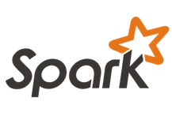
Apache Spark scales!!
Spark Application (Driver Program)
Spark programs generally consist of two components: driver program and worker program(s)
Driver Program manages the division of computations (Task) that are sent to worker nodes
Worker programs run smaller portions of computations
The SparkContext object instructs Spark on how & where to access a cluster
Cluster Manager manages the physical resources needed to run driver and worker programs.
SparkContext
Cluster Manager
Local Threads
Worker Node
Worker Node
Spark Executor
Spark Executor
Cache
Cache
Swift (SoftLayer), AWS S3, HDFS, or other storage
Notes:
Spark has 2 main parts, Driver and Worker programs.
The Driver Program manages the division of computations (or Task) that are sent to worker nodes
The Worker nodes run the task or smaller portions of computations
The SparkContext which is part of driver interacts with programing layer and instructs Spark on how to access the cluster
The Cluster Manager manages the physical resources needed to run driver and worker programs.

Slide 29
IBM is all-in on Spark
Contribute to the Core
Launch Spark Technology Cluster (STC), 300 engineers
Open source SystemML
Partner with Databricks
Foster Community
Infuse the Portfolio
Integrate Spark throughout portfolio
3,500 employees working on Spark-related topics
Spark however customers want it – standalone, platform or products
Educate 1M+ data scientists and engineers via online courses
Sponsor AMPLab, creators and evangelists of Spark
Notes:
AMPLab – (algorithms, Machines, People) at University of California, Berkeley
IBM Distribution is called IODPi
Spark as a service on bluemix

Slide 30


IBM had a significant impact on Spark 2.0
IBM is #2 contributor to Apache Spark
IBM was the leading contributor in Spark 2.0 to SparkML, PySpark, and SparkR
Notes:
Any did you know that IBM is a leader in contributing to Apache Spark? It’s not just marketing folks – we’ve put in the work to earn the hearts and minds of today’s Data Scientists. And we need every customer to hear about all of the work that we’ve done. If the customer is looking for their “open source partner” then they need to seriously consider IBM – no one has put more effort into the machine learning and data science components of Apache Spark than us.
Overall, IBM was the second largest contributor to Spark 2.0 – contributing more than the next 5 companies combined (note – that’s more than Hortonworks, Cloudera, Intel, IVU Traffic Technologies, and Tencant – combined!). IBM was a major contributor across the Spark ecosystem – and was the top contributor to key data science components such as SparkML, PySpark, and SparkR.

Slide 31
IBM impact on SparkML / MLlib 2.0
Spark Machine Learning (ML) provides a toolset to create pipelines of different ML related transformations on your data
IBM is #1 contributor in the Spark (ML)
Distinction between ML and MLlib:
MLlib is based on RDDs; ML is based on data frames.
The distinction between both is fading out. In general they usually combine both under the name "Spark ML"
Notes:
Here’s a chart on SparkML – Apache Spark’s machine learning library. IBM is the top contributor to SparkML in Spark 2.0, at 34% of total contributions to the library.
And as I said, IBM was also the top contributor to PySpark (the Python API for Apache Spark) and SparkR (the R API for Apache Spark). Data Scientists typically code in which two languages? Python and R!

